Slide 1
Image classification
Data: Identify the plant based on its leaf image
April 20, 2021

Slide 2
Introduction to project
In this project, designed a prototype system, which does a botanist's job. It simply takes an image of the plant (specially the leaf) and predicts the class of problem going on with the plant.

Slide 3


Agenda
Data:
Read dataset (train and test)
image -.jpg & filename-label - .csv
Task:
Split data as train-validation
Extract features
Develop convolution neural network model
Performance measure
Accuracy

Slide 4
Data

Slide 5
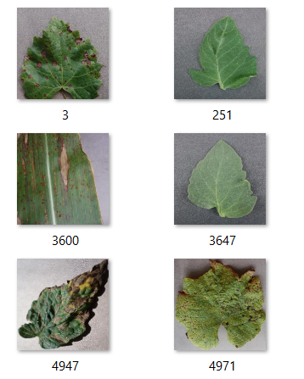
Image dataset & its label
Introduction to data
Extract the image from .jpg file and its corresponding label from the .csv file
Filename | Label
3 | 12
251 | 31
3600 | 11
3647 | 31
4947 | 30
4971 | 15

Slide 6
Labeling dataset
Plant | Label
Apple | 1, 2, 3, 4
Blueberry | 5
Cherry | 6, 7
Corn | 8, 9, 10,11
Grape | 12, 13, 14, 15
Orange | 16
Peach | 17, 18
Pepper | 19, 20
Plant | Label
Potato | 21, 22, 23
Raspberry | 24
Soybean | 25
Squash | 26
Strawberry | 27, 28
Tomato | 29, 30, 31, 32, 33, 34, 35, 36, 37, 38

Slide 7
Task

Slide 8
Predict the label of given image
Data pre-processing
Read train and test data (initially)
Train data size – 50,000 images
Test data size – 1,250 images
Split train data into train-validation dataset
Train data size – 33,750 images
Validation data size – 11,250 images
Perform feature extraction using ImageDataGenerator()
Model training
Developed Sequential CNN model
Input layer – Conv2D
Input data size is (32,32,3) – color image
Hidden layer
Convolution layer: Conv2D
Pooling layer: Max Pooling
Output layer – SoftMax
Output data size is 38 labels

Slide 9
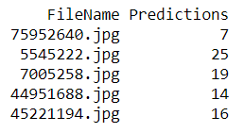
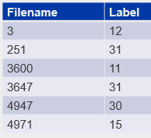
CNN model
Soft
max
Predicted
label
Image
Conv2D
….……….
Label
Input layer
Hidden layer
Output layer

Slide 10
Performance measure

Slide 11
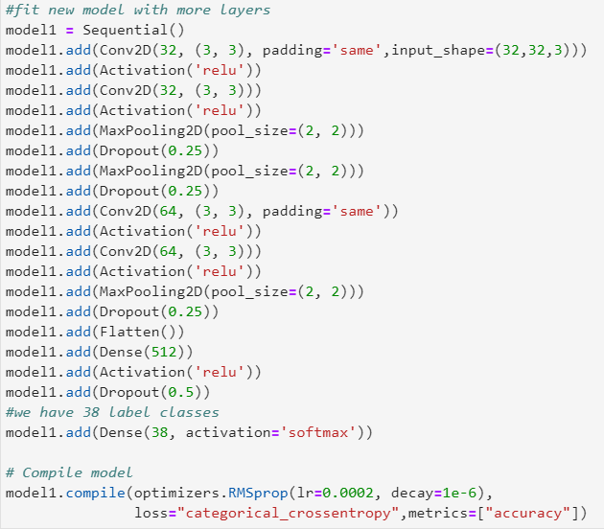
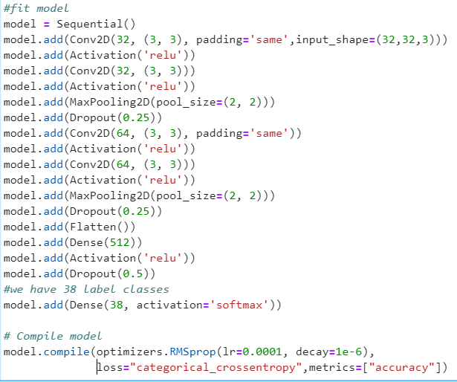
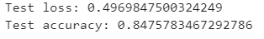
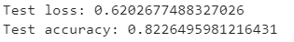
Validating model
Number of hidden layer = 17
On validation data attained accuracy score of 84%
Number of hidden layer = 19
On validation data attained accuracy score of 82%

Slide 12
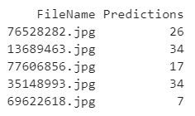
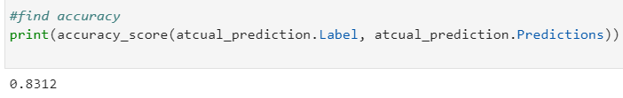
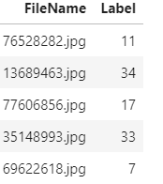
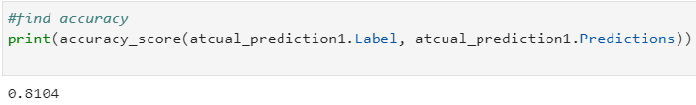
Model prediction and accuracy
Predictions -sample
Actual - sample
Model accuracy
Applied performance measure as accuracy between the prediction and actual labels
Attainted an accuracy score of
Model 1: 83%
Model 2: 81%

Slide 13
Suggestions
To improve model accuracy, try different
activation functions
regularization functions

Slide 14
Q&A

Slide 15
Thank You

